Slide 1

Mistral Explained (7B and 8x7B)

Slide 2
Prerequisites
Topics
Structure of the Transformer model and how the attention mechanism works
Architectural differences between the vanilla Transformer and Mistral
Sliding Window Attention
Review of self-attention
Receptive field
KV-Cache
Motivation
How it works
Rolling Buffer Cache
Pre-fill and chunking
Sparse Mixture of Experts
Model Sharding
Pipeline Parallelism
Understanding the Mistral model’s code
Block attention in xformers
Topics not covered
RMS Normalization
Rotary Positional Encoding
Grouped Query Attention

Slide 3
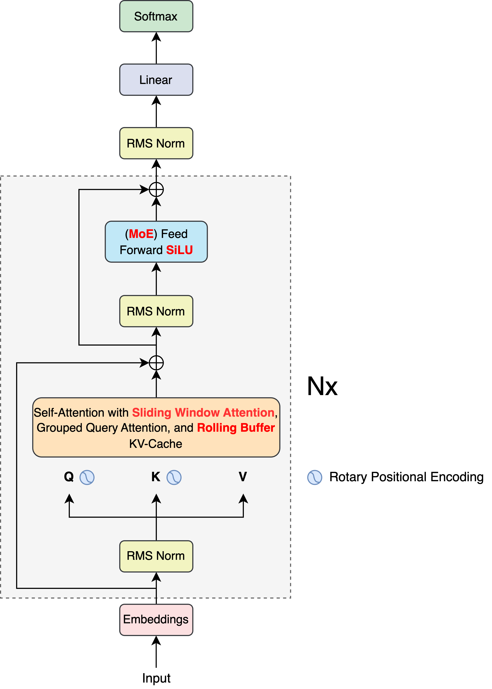
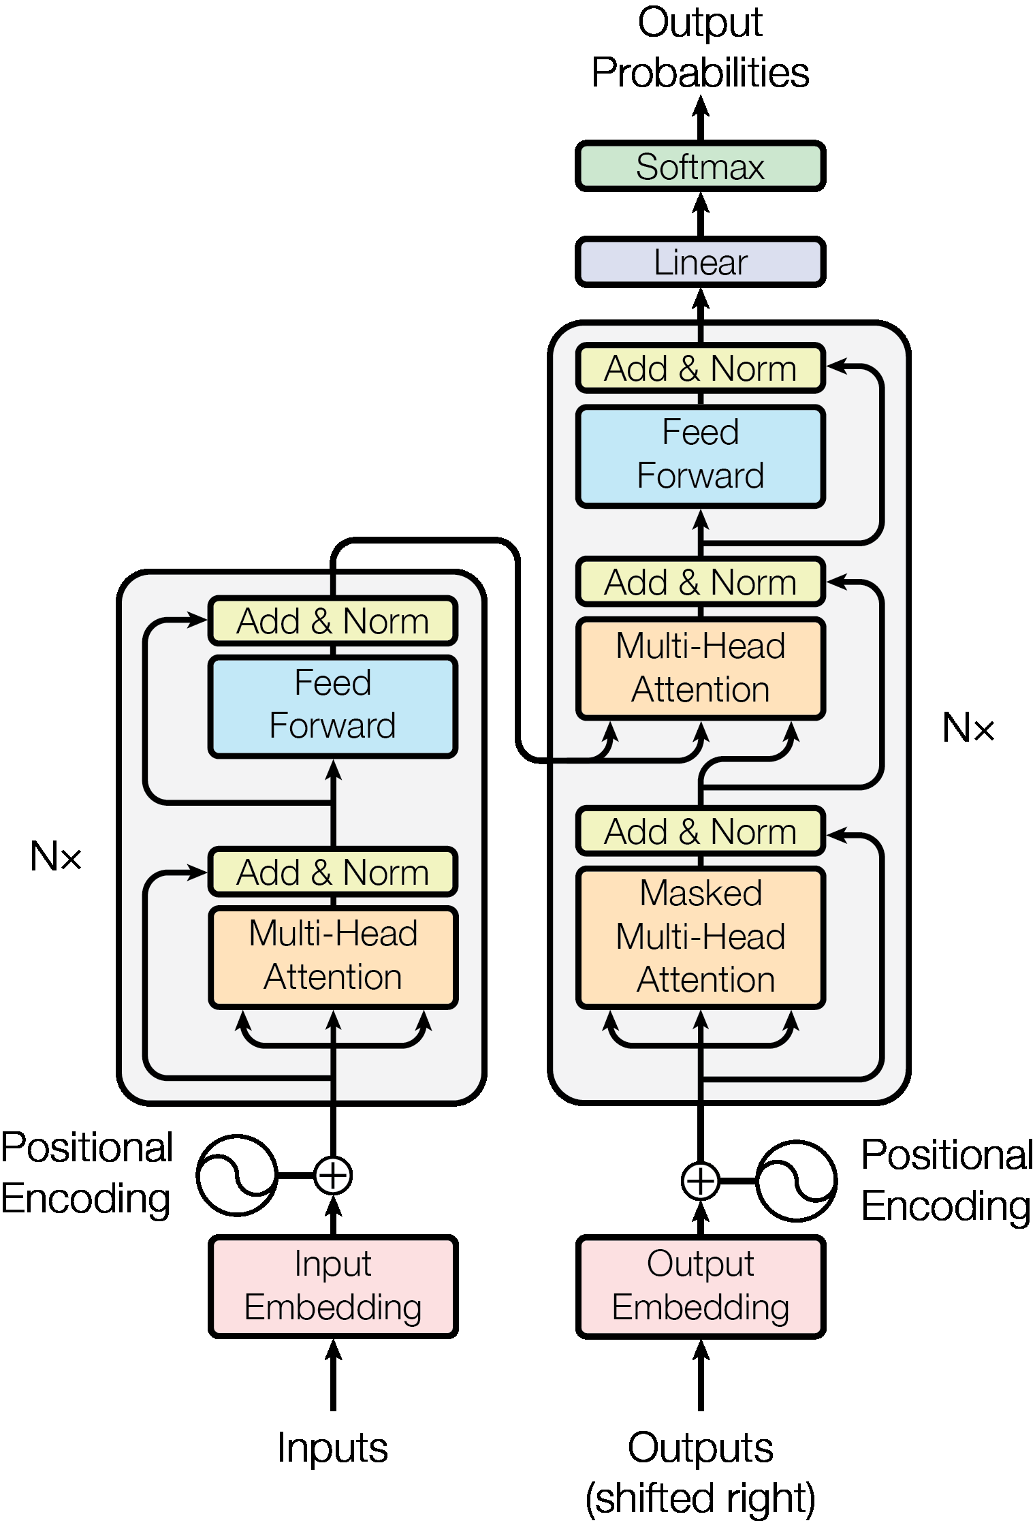
Transformer vs Mistral
Transformer (“Attention is all you need”)
Mistral

Slide 4
Models
Parameter | Description | 7B | 8x7B | Notes
dim | Size of the embedding vector | 4096 | 4096
n_layers | Number of decoder layers | 32 | 32
head_dim | dim / n_heads | 128 | 128
hidden_dim | Hidden dimension in the feed forward layer | 14336 | 14336
n_heads | Number of attention heads (Q) | 32 | 32 | Different numbers because of Grouped Query Attention
n_kv_heads | Number of attention heads (K, V) | 8 | 8
windows_size | Size of the sliding window for attention calculation and Rolling Cache | 4096 | N/A | window_size is not set in the params.json of the 8x7B model
context_len | Context on which model was trained upon | 8192 | 32000 | For 8x7B, values are from official announcement page
vocab_size | Number of tokens in the vocabulary | 32000 | 32000 | The tokenizer is the SentencePiece tokenizer
num_experts_per_token | Number of expert models for each token | N/A | 2 | Sparse Mixture of Experts only available for 8x7B
num_experts | Number of expert models | N/A | 8
Next Token
Prompt

Slide 5
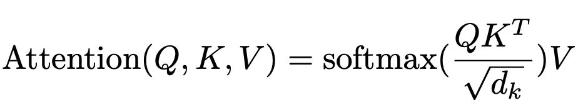
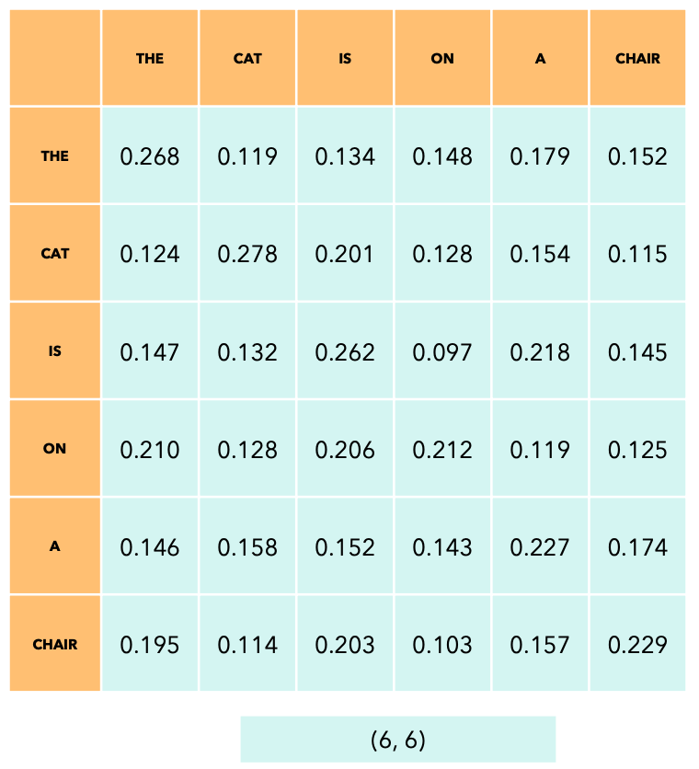
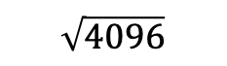
What is Self-Attention?
Self-Attention allows the model to relate words to one another. Imagine we have the following sentence: “The cat is on the chair”
Here, the product of Q and K matrix is shown before applying the softmax.
Q
K^{T}
X
=
* all values are random
(6, 4096)
(4096, 6)
$$\sqrt{4096}$$

Slide 6
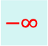
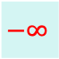
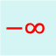
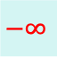
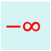
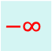
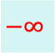
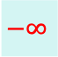
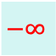
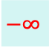
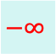
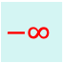
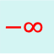
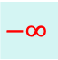
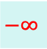
Let’s apply a causal mask
After applying the causal mask, we apply softmax, which makes the remaining values on the row sum up to 1.
Now let’s look at the sliding window attention.
Q
K^{T}
$$−∞$$
$$−∞$$
$$−∞$$
$$−∞$$
$$−∞$$
$$−∞$$
$$−∞$$
$$−∞$$
$$−∞$$
X
$$−∞$$
$$−∞$$
$$−∞$$
* all values are random
=
(6, 4096)
(4096, 6)
$$−∞$$
$$−∞$$
$$\sqrt{4096}$$
$$−∞$$

Slide 7
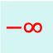
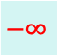

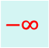
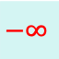
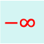
Let’s apply sliding window attention
The sliding window size is 3.
Q
K^{T}
$$−∞$$
$$−∞$$
$$−∞$$
$$−∞$$
$$−∞$$
$$−∞$$
$$−∞$$
$$−∞$$
$$−∞$$
X
$$−∞$$
$$−∞$$
$$−∞$$
* all values are random
=
(6, 4096)
(4096, 6)
$$−∞$$
$$−∞$$
$$−∞$$
$$\sqrt{4096}$$
$$−∞$$
$$−∞$$
$$−∞$$
$$−∞$$
$$−∞$$
$$−∞$$

Slide 8
Sliding Window Attention: The Details
Reduces the number of dot product to perform, and thus, performance during training and inference.
Sliding window attention may lead to degradation in the performance of the model, as some “interactions” between tokens will not be captured.
The model mostly focuses on the local context, which depending on the size of the window, is enough for most cases. This makes sense if you think about a book; the words in a paragraph in chapter 5 depend on the paragraphs in the same chapter but may be entirely unrelated to the words in chapter 1.
Sliding window attention can still allow one token to attend to tokens outside the window, using a reasoning similar to receptive field in convolutional neural networks.

Slide 9
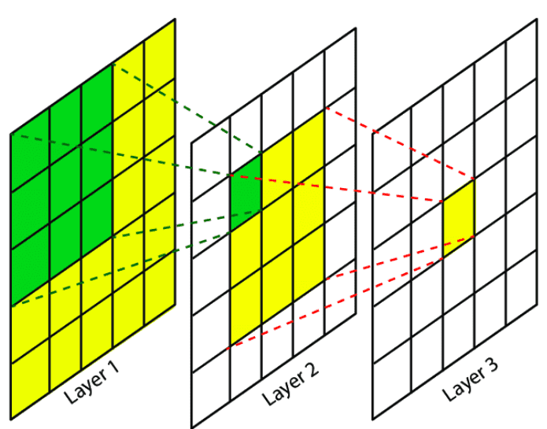
Receptive Field in CNN
This feature depends directly on 9 features of the previous layers, but indirectly on all the features of the initial layer, since each feature of the intermediate layer depends on 9 features of the previous layer. This means a change in any of the features in layer 1 will influence this feature as well.

Slide 10
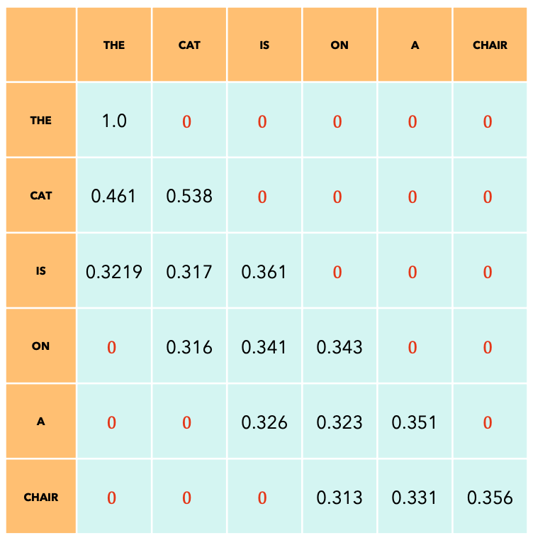
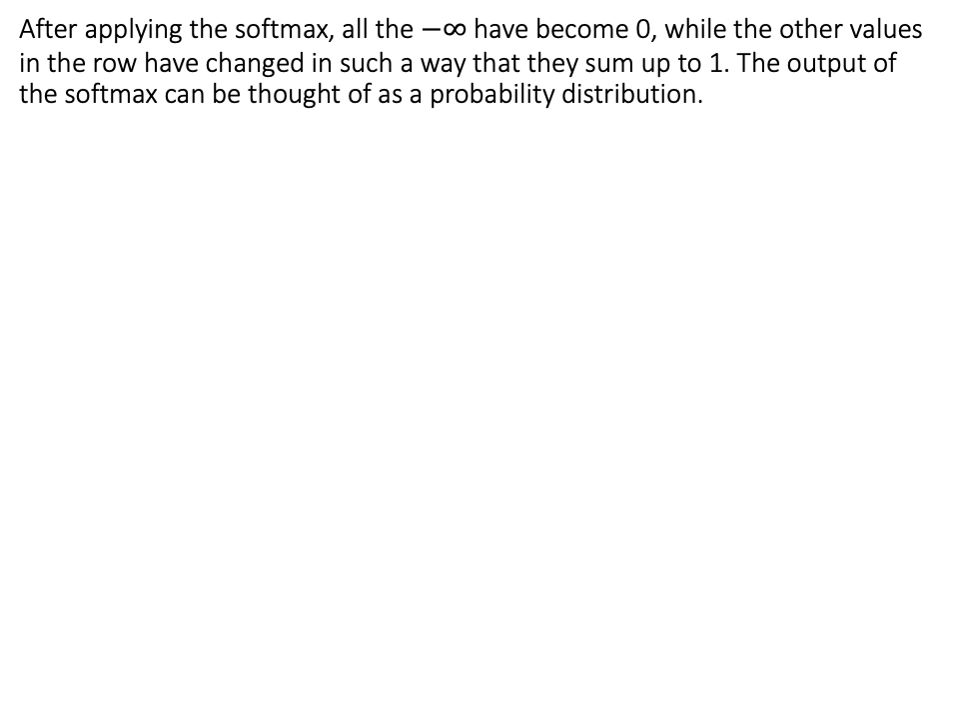
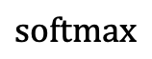
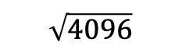
Sliding Window Attention: Information Flow (1)
After applying the softmax, all the $−∞$ have become 0, while the other values in the row have changed in such a way that they sum up to 1. The output of the softmax can be thought of as a probability distribution.
Q
K^{T}
X
$$\text{softmax}$$
=
(6, 4096)
(4096, 6)
$$\sqrt{4096}$$

Slide 11
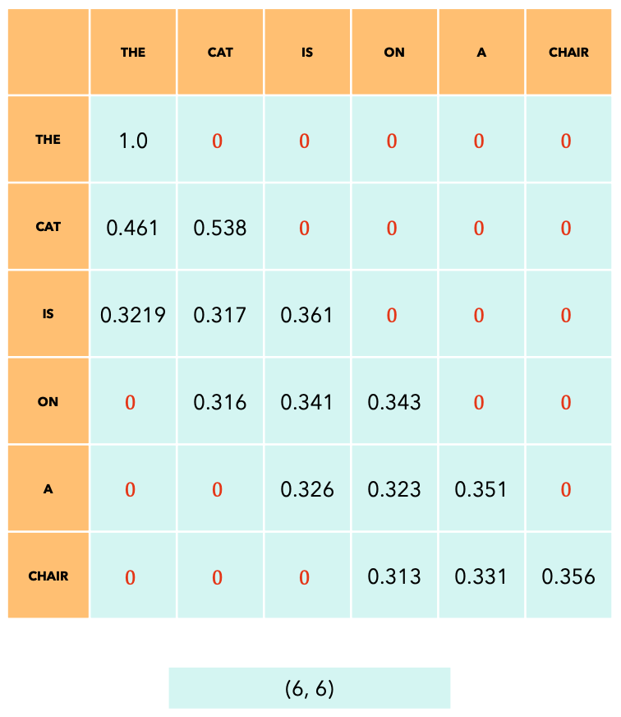
Sliding Window Attention: Information Flow (2)
The output of the Self-Attention is a matrix of the same shape as the input sequence, but where each token now captures the information about other tokens according to the mask applied. In our case, the last token of the output captures information about itself and the two preceding tokens.
V
Output
X
=
(6, 4096)
(6, 4096)

Slide 12
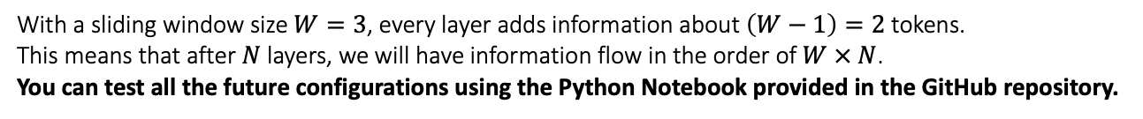
Sliding Window Attention: Information Flow (3)
THE
THE
THE
CAT
THE, CAT
THE, CAT
IS
THE, CAT, IS
THE, CAT, IS
ON
CAT, IS, ON
THE, CAT, IS, ON
Layer 1
Layer 2
A
IS, ON, A
THE, CAT, IS, ON, A
CHAIR
ON, A, CHAIR
CAT, IS, ON, A, CHAIR
(6, 4096)
(6, 4096)
(6, 4096)
With a sliding window size $W=3$, every layer adds information about $\left(W−1\right)=2$ tokens.
This means that after $N$ layers, we will have information flow in the order of $W × N$.
You can test all the future configurations using the Python Notebook provided in the GitHub repository.

Slide 13
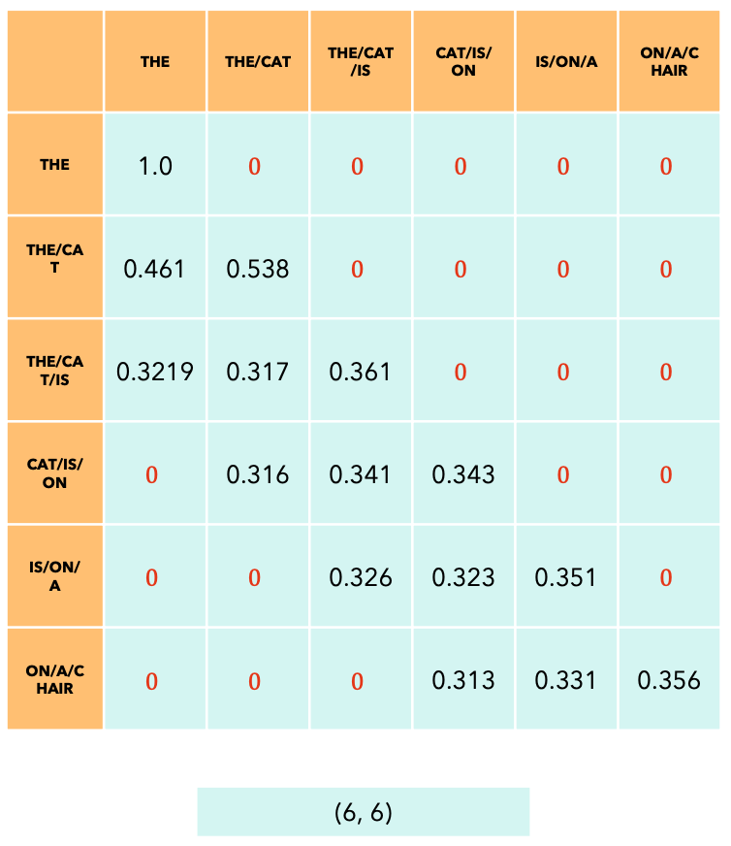
Sliding Window Attention: Information Flow (4)
V
Output
X
=
(6, 4096)
(6, 4096)

Slide 14
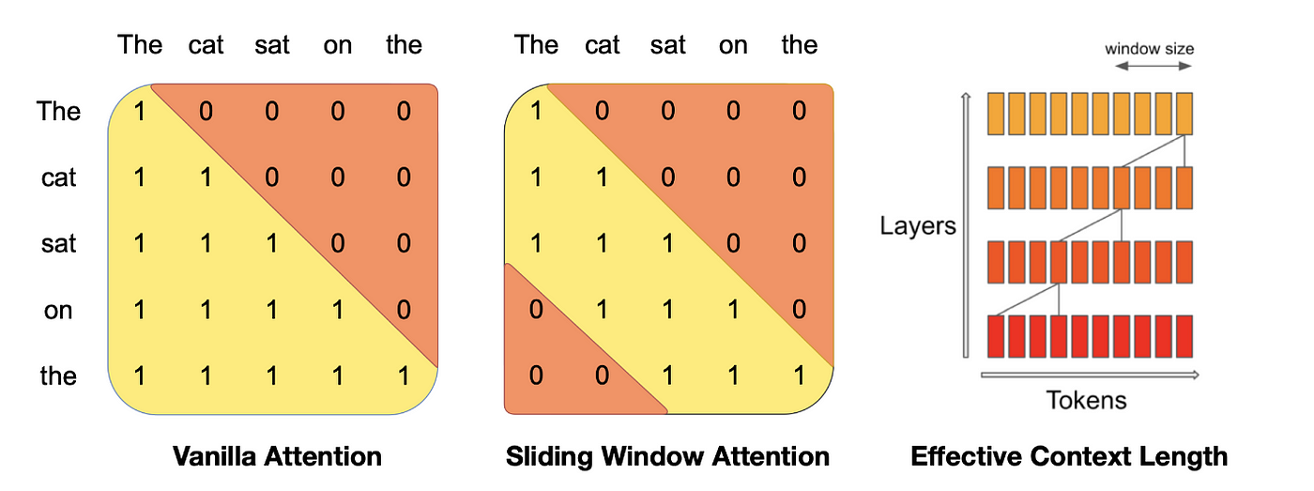
Sliding Window Attention: Information Flow (5)
As you can see, the information flow is very similar to the receptive field on a CNN.

Slide 15
Next Token Prediction Task
Imagine we want to train a model to write Dante Alighieri’s Divine Comedy’s 5th Canto from the Inferno.
Amor, ch'al cor gentil ratto s'apprende,
prese costui de la bella persona
che mi fu tolta; e 'I modo ancor m'offende.
Amor, ch'a nullo amato amar perdona,
mi prese del costui piacer si forte,
che, come vedi, ancor non m'abbandona.
Amor condusse noi ad una morte.
Caina attende chi a vita ci spense.
Love, that can quickly seize the gentle heart,
took hold of him because of the fair body
taken from me-how that was done still wounds me.
Love, that releases no beloved from loving,
took hold of me so strongly through his beauty
that, as you see, it has not left me yet.
Love led the two of us unto one death.
Caina waits for him who took our life.”

Slide 16
Next Token Prediction Task
Target Love that can quickly seize the gentle heart [EOS]
Training
Input [SOS] Love that can quickly seize the gentle heart

Slide 17
Next Token Prediction Task
Output Love
Inference
T=1
Input [SOS]

Slide 18
Next Token Prediction Task
Output Love that
Inference
T=2
Input [SOS] Love

Slide 19
Next Token Prediction Task
Output Love that can
Inference
T=3
Input [SOS] Love that

Slide 20
Next Token Prediction Task
Output Love that can quickly
Inference
T=4
Input [SOS] Love that can

Slide 21
Next Token Prediction Task
Output Love that can quickly seize
Inference
T=5
Input [SOS] Love that can quickly

Slide 22
Next Token Prediction Task
Output Love that can quickly seize the
Inference
T=6
Input [SOS] Love that can quickly seize

Slide 23
Next Token Prediction Task
Output Love that can quickly seize the gentle
Inference
T=7
Input [SOS] Love that can quickly seize the

Slide 24
Next Token Prediction Task
Output Love that can quickly seize the gentle heart
Inference
T=8
Input [SOS] Love that can quickly seize the gentle

Slide 25
Next Token Prediction Task
Output Love that can quickly seize the gentle heart [EOS]
Inference
T=9
Input [SOS] Love that can quickly seize the gentle heart

Slide 26
Next Token Prediction Task: The Motivation behind KV-Cache
At every step of the inference, we are only interested in the last token output by the model, because we already have the previous tokens. However, the model needs access to all previous tokens to decide on which token to output, since they constitute its context (or the “prompt”).
Is there a way to make the model do less computation on the token it has already seen during inference? YES! The solution is KV-Cache!

Slide 27
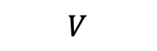
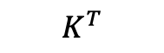
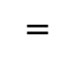
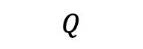
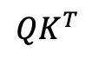
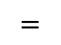
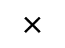
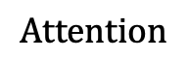
Self-Attention during Next Token Prediction Task
$$QK^{T}$$
$$Q$$
$$K^{T}$$
$$V$$
$$\text{Attention}$$
Token 1
Token 1
Token 1
Output Token 1
Token 2
Token 2
Token 2
Output Token 2
Token 3
Token 3
Token 3
Output Token 3
Token 4
Token 4
Token 4
Output Token 4
Token 5
$$×$$
$$=$$
$$×$$
Token 5
$$=$$
Output Token 5
Token 6
Token 5
Token 6
Output Token 6
Token 7
Token 6
Token 7
Output Token 7
Token 8
Token 7
Token 8
Output Token 8
Token 9
Token 8
Token 9
Output Token 9
Token 9
(9, 4096)
(4096, 9)
(9, 4096)
(9, 4096)
(9, 9)

Slide 28
Self-Attention during Next Token Prediction Task
$$QK^{T}$$
$$Q$$
$$K^{T}$$
$$V$$
$$\text{Attention}$$
Token 1
Token 1
Output Token 1
$$×$$
$$=$$
$$×$$
$$=$$
Token 1
(1, 4096)
(4096, 1)
(1, 4096)
(1, 4096)
Inference T=1
(1, 1)

Slide 29
Self-Attention during Next Token Prediction Task
$$QK^{T}$$
$$Q$$
$$K^{T}$$
$$V$$
$$\text{Attention}$$
Token 1
Token 1
Output Token 1
Token 2
Token 2
Output Token 2
$$×$$
$$=$$
$$×$$
$$=$$
Token 1
Token 2
(2, 4096)
(4096, 2)
(2, 4096)
(2, 4096)
Inference T=2
(2, 2)

Slide 30
Self-Attention during Next Token Prediction Task
$$QK^{T}$$
$$Q$$
$$K^{T}$$
$$V$$
$$\text{Attention}$$
Token 1
Token 1
Output Token 1
Token 2
Token 2
Output Token 2
Token 3
Token 3
Output Token 3
$$×$$
$$=$$
$$×$$
$$=$$
Token 1
Token 2
Token 3
(3, 4096)
(4096, 3)
(3, 4096)
(3, 4096)
Inference T=3
(3, 3)

Slide 31
Self-Attention during Next Token Prediction Task
$$QK^{T}$$
$$Q$$
$$K^{T}$$
$$V$$
$$\text{Attention}$$
Token 1
Token 1
Output Token 1
Token 2
Token 2
Output Token 2
Token 3
Token 3
Output Token 3
Token 4
Token 4
Output Token 4
$$×$$
$$=$$
$$×$$
$$=$$
Token 1
Token 2
Token 3
Token 4
(4, 4096)
(4096, 4)
(4, 4096)
(4, 4096)
Inference T=4
(4, 4)

Slide 32
1. We already computed these dot products in the previous steps. Can we cache them?
2. Since the model is causal, we don’t care about the attention of a token with its successors, but only with the tokens before it.
3. We don’t care about these, as we want to predict the next token and we have already predicted the previous ones.
$$QK^{T}$$
$$Q$$
$$K^{T}$$
$$V$$
$$\text{Attention}$$
Token 1
Token 1
Output Token 1
Token 2
Token 2
Output Token 2
Token 3
Token 3
Output Token 3
Token 4
Token 4
Output Token 4
$$×$$
$$=$$
$$×$$
$$=$$
Token 1
Token 2
Token 3
Token 4
4. We are only interested in this last row!
(4, 4096)
(4096, 4)
(4, 4096)
(4, 4096)
Inference T=4
(4, 4)

Slide 33


Slide 34
Self-Attention with KV-Cache
$$QK^{T}$$
$$Q$$
$$K^{T}$$
$$V$$
$$\text{Attention}$$
Token 1
Token 1
Output Token 1
$$×$$
$$=$$
$$×$$
$$=$$
Token 1
(1, 4096)
(4096, 1)
(1, 4096)
(1, 4096)
Inference T=1
(1, 1)

Slide 35
Self-Attention with KV-Cache
$$QK^{T}$$
$$Q$$
$$K^{T}$$
$$V$$
$$\text{Attention}$$
Token 1
Token 2
Token 2
Output Token 2
$$×$$
$$=$$
$$×$$
$$=$$
Token 1
Token 2
(2, 4096)
(4096, 2)
(2, 4096)
(2, 4096)
Inference T=2
(2, 2)

Slide 36
Self-Attention with KV-Cache
$$QK^{T}$$
$$Q$$
$$K^{T}$$
$$V$$
$$\text{Attention}$$
Token 1
Token 2
Token 3
Token 3
Output Token 3
$$×$$
$$=$$
$$×$$
$$=$$
Token 1
Token 2
Token 3
(3, 4096)
(4096, 3)
(3, 4096)
(3, 4096)
Inference T=3
(3, 3)

Slide 37
Self-Attention with KV-Cache
$$QK^{T}$$
$$Q$$
$$K^{T}$$
$$V$$
$$\text{Attention}$$
Token 1
Token 2
Token 3
Token 4
Token 4
Output Token 4
$$×$$
$$=$$
$$×$$
$$=$$
Token 1
Token 2
Token 3
Token 4
(4, 4096)
(4096, 4)
(4, 4096)
(4, 4096)
Inference T=4
(4, 4)

Slide 38
Rolling Buffer Cache
Since we are using Sliding Window Attention (with size W), we don’t need to keep all the previous tokens in the KV-Cache, but we can limit it to the latest W tokens.

Slide 39
The Motivation
We don’t care about these either, as we want the output token to only depend on the previous 4 tokens!
$$QK^{T}$$
$$Q$$
$$K^{T}$$
If our sliding window was 4, we would only want the dot-product of the current token with the previous 4 tokens (including the token itself)
$$V$$
$$\text{Attention}$$
Token 1
Token 1
Token 2
Token 2
Token 3
Token 3
Token 4
Token 4
$$×$$
$$=$$
$$×$$
Token 5
$$=$$
Token 5
Token 6
Token 6
Token 7
Token 7
Token 8
Token 9
Token 8
Token 9
Output Token 9
Token 9
(9, 4096)
(4096, 9)
(9, 4096)
(1, 4096)
Inference T=9
(1, 9)

Slide 40
Rolling Buffer Cache: How does it work?
We keep track of a write pointer that tells us where we added the last token in the rolling buffer cache.
We add a new token and move the pointer forward.
Let’s add the sentence “The cat is on a chair”
THE
Write pointer

Slide 41
Rolling Buffer Cache: How does it work?
We keep track of a write pointer that tells us where we added the last token in the rolling buffer cache.
We add a new token and move the pointer forward.
Let’s add the sentence “The cat is on a chair”
THE
CAT
Write pointer

Slide 42
Rolling Buffer Cache: How does it work?
We keep track of a write pointer that tells us where we added the last token in the rolling buffer cache.
We add a new token and move the pointer forward.
Let’s add the sentence “The cat is on a chair”
THE
CAT
IS
Write pointer

Slide 43
Rolling Buffer Cache: How does it work?
We keep track of a write pointer that tells us where we added the last token in the rolling buffer cache.
We add a new token and move the pointer forward.
Let’s add the sentence “The cat is on a chair”
THE
CAT
IS
ON
Write pointer

Slide 44
Rolling Buffer Cache: How does it work?
We keep track of a write pointer that tells us where we added the last token in the rolling buffer cache.
We add a new token and move the pointer forward.
Let’s add the sentence “The cat is on a chair”
A
CAT
IS
ON
Write pointer

Slide 45
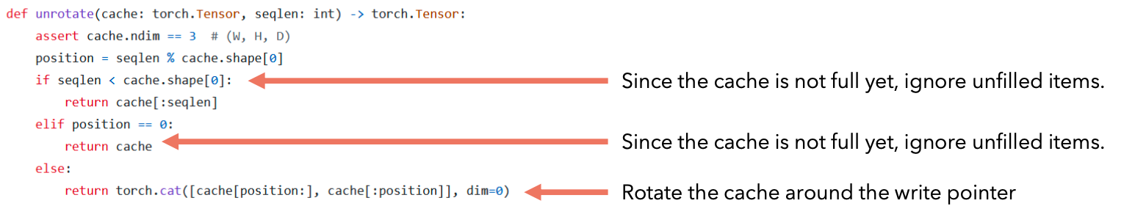
Rolling Buffer Cache: Unrolling
Imagine we want to “unroll” the cache because we want to calculate the attention of the incoming token. It’s very easy! We just need to use the write pointer to understand how to order the items: We first take all the items AFTER the write pointer, and then all the items from the 0th index up to the position of the write pointer (inclusive).
A
CAT
IS
ON
Write pointer
CAT
IS
ON
A

Slide 46
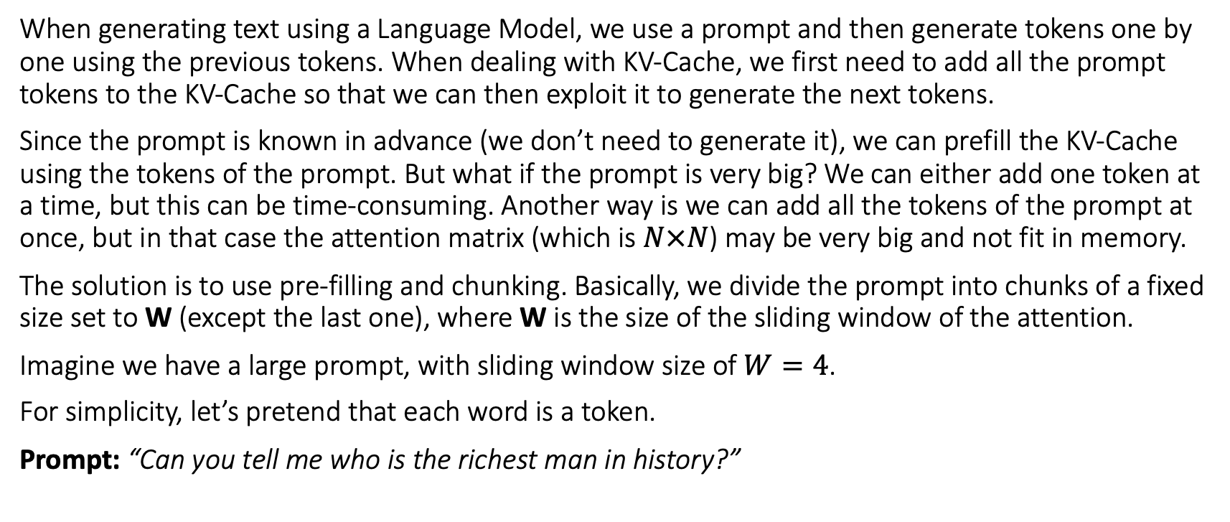
Pre-fill and chunking
When generating text using a Language Model, we use a prompt and then generate tokens one by one using the previous tokens. When dealing with KV-Cache, we first need to add all the prompt tokens to the KV-Cache so that we can then exploit it to generate the next tokens.
Since the prompt is known in advance (we don’t need to generate it), we can prefill the KV-Cache using the tokens of the prompt. But what if the prompt is very big? We can either add one token at a time, but this can be time-consuming. Another way is we can add all the tokens of the prompt at once, but in that case the attention matrix (which is $N×N$) may be very big and not fit in memory.
The solution is to use pre-filling and chunking. Basically, we divide the prompt into chunks of a fixed size set to W (except the last one), where W is the size of the sliding window of the attention.
Imagine we have a large prompt, with sliding window size of $W=4$.
For simplicity, let’s pretend that each word is a token.
Prompt: “Can you tell me who is the richest man in history?”

Slide 47
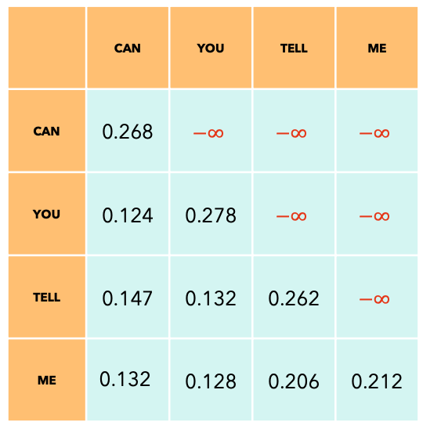
Pre-fill and chunking: First chunk
Prompt: “Can you tell me who is the richest man in history?”
KV-Cache
At every step, we calculate the attention using the tokens of the KV-Cache + the tokens of the current chunk as Keys and Values, while only the tokens of the incoming chunk as Query. During the first step of pre-fill, the KV-Cache is initially empty.
After calculating the attention, we add the tokens of the current chunk to the KV-Cache. This is different from token generation in which we first add the previously-generated token to the KV-Cache and then calculate the attention. We will see later why.
Attention mask

Slide 48
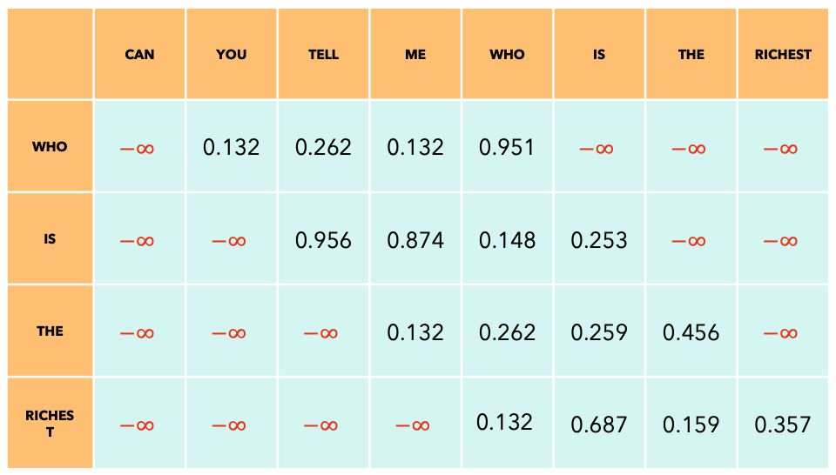
Pre-fill and chunking: Second chunk
Prompt: “Can you tell me who is the richest man in history?”
KV-Cache
CAN
YOU
TELL
ME
You may have noticed that the size of the attention mask is bigger than the KV-Cache. This is done on purpose, otherwise the newly added tokens will not have their dot products calculated with the items that were previously in the cache (for example the word ”Who” will not have its attention calculated with the previous tokens). This mechanism is only used during pre-fill of the prompt. Why do we do it like this? Because KV-Cache has a fixed size, but at the same time we need all these attentions computed.
Let’s review how this is implemented in code.
Attention mask

Slide 49
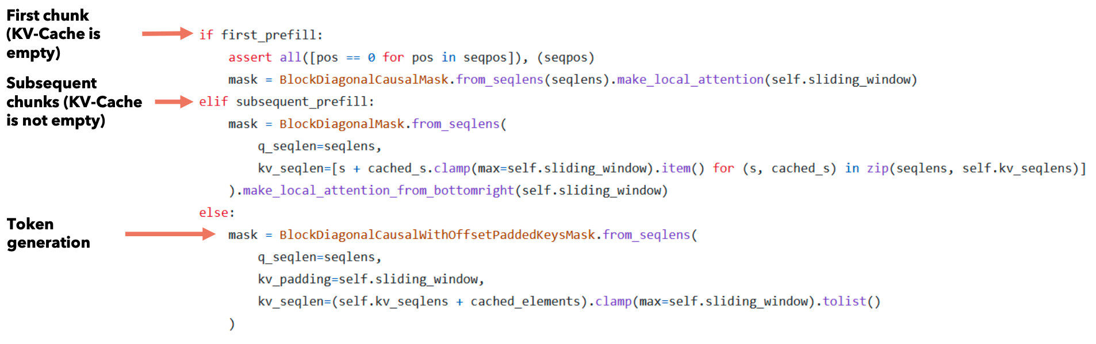
Pre-fill and chunking: Code reference
Only during pre-fill, the attention is calculated using an attention mask that is bigger than the KV-Cache.
As you can see, during the pre-fill of the first chunk and subsequent chunks, we use the size of the KV-Cache and the number of tokens in the current chunk to generate the attention mask.
During pre-fill, the attention mask is calculated using the KV-Cache + the tokens in the current chunk, so the size of the attention mask can be bigger than that of the KV-Cache (W).
During generation, we first add the previous token to the KV-Cache and then use the contents of the KV-Cache to generate the attention mask. During generation, the size of the attention mask is the size of the KV-Cache (W).

Slide 50
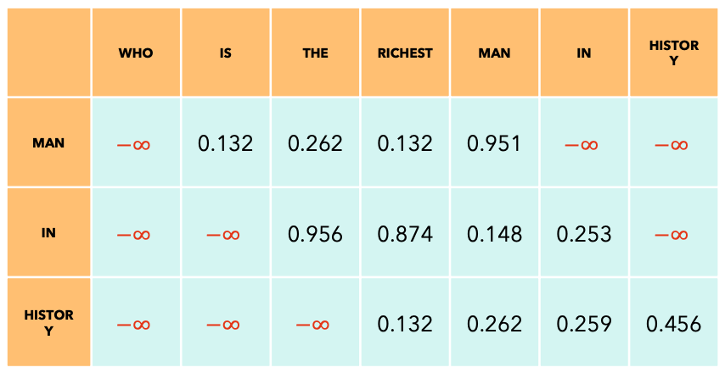
Pre-fill and chunking: Last chunk
Prompt: “Can you tell me who is the richest man in history?”
KV-Cache
WHO
IS
THE
RICHEST
The last chunk may be smaller, that’s why we have less rows.
Attention mask

Slide 51
Mixture of Experts: An Introduction
Mixture of Experts is an ensemble technique, in which we have multiple “expert” models, each trained on a subset of the data, such that each model specializes on it and then the output of the experts are combined (usually a weighted sum or by averaging) to produce one single output.

Slide 52
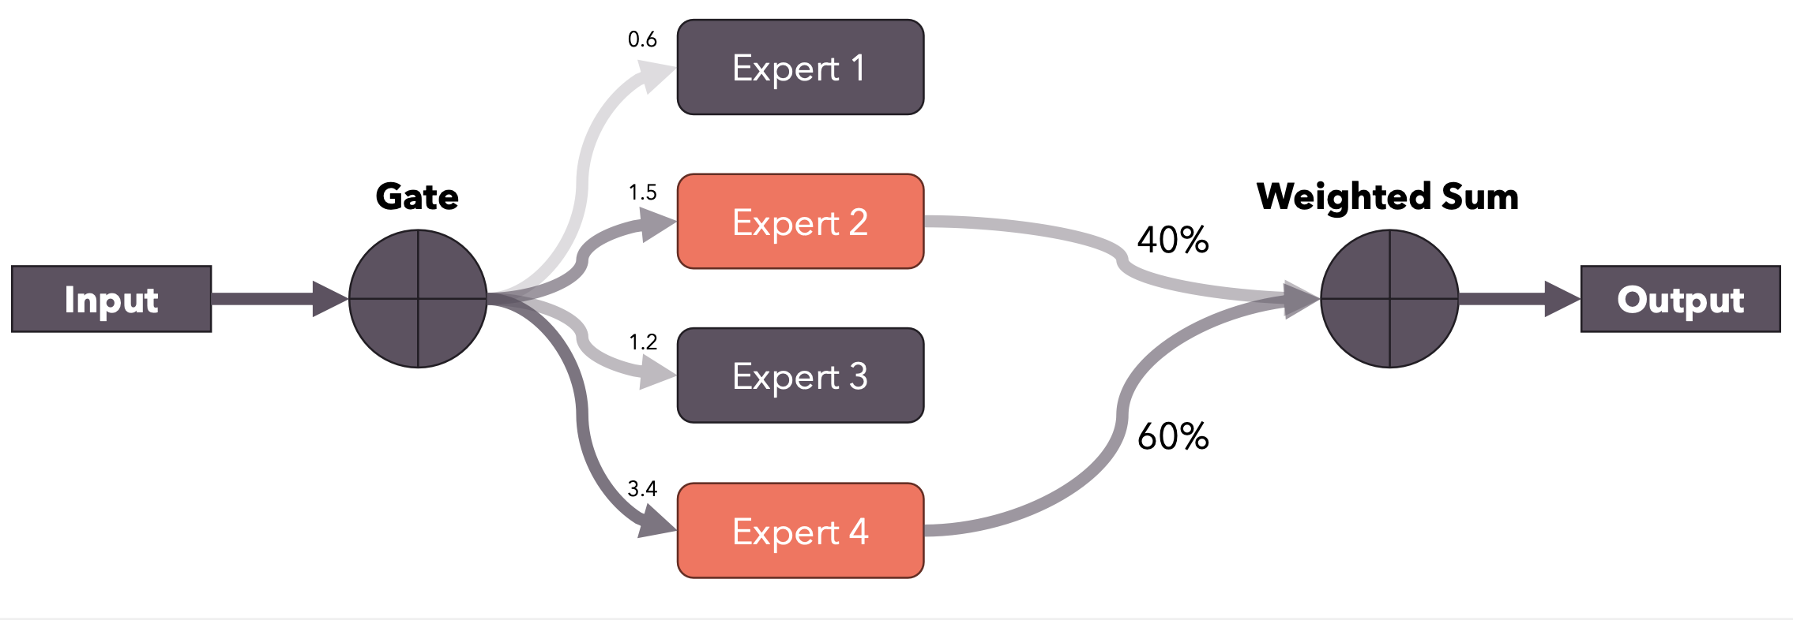
Mixture of Experts: An Introduction
In the case of Mistral 8x7B, we talk about Sparse Mixture of Experts (SMoE), because only 2 out of 8 experts are used for every token.
The gate produces logits which are used to select the top-k experts. The top-k logits are then run through a softmax to product weights.
*Numbers are randomly generated

Slide 53
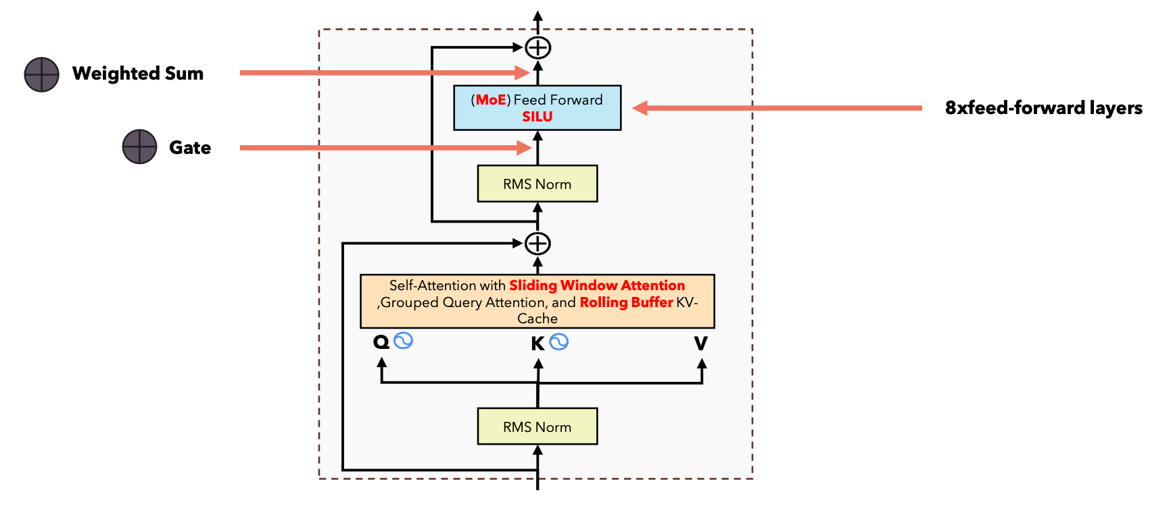
Mistral 8x7B: Expert feed-forward layers
In the case of Mistral 8x7B, the experts are the feed-forward layers present at every Encoder layer. Each Encoder layer is comprised of a single Self-Attention mechanism, followed by a mixture of experts of 8 FFN. The gate function selects the top 2 experts for each incoming token. The output is combined with a weighted sum.
This allows to increase the parameters of the model, but without impacting the computation time, since the input will only pass through the top 2 experts, so the intermediate matrix multiplications will only be performed on the selected experts.

Slide 54

Mistral 8x7B: The Gating Function
The gating function is just a linear layer (in_features=4096, out_features=8, bias=False) that’s trained along with the rest of the model. For each token embedding, it produces 8 logits, which indicate which experts to select.

Slide 55
Mixture of Experts: Why we apply the softmax after selecting the top-k experts?
If we apply the softmax directly to the output of the gate function, it will result in a “probability distribution” (weights sum up to 1) over all the experts. But since we are only going to use the top-k of them, we want a “probability distribution” over only the selected experts.
This also makes it easier to compare two models trained on different number of experts, since the sum of the weights applied to the output will always be 1 independent of the number of experts chosen by the gate function.

Slide 56

Model Sharding
When we have a model that is too big to fit in a single GPU, we can divide the model into “groups of layers” and place each group of layers in a GPU. When we inference iteratively, the output of each GPU is fed as input to the next GPU, and so on...
In the case of Mistral, since we have 32 Encoder layers, if we have 4 GPUs, we can store 8 of them in each GPU.
A pipeline like this one works fine, but it is not very efficient, because at any time only one GPU is working. A better approach (not implemented in the open-source release of Mistral), used especially during training, is to work on multiple batches at the same time, but shift them on the time scale. This approach is known as Pipeline Parallelism. Let’s see how it works.

Slide 57

Pipeline Parallelism

Slide 58
Pipeline Parallelism: The Problem
Imagine we want to train our sharded model on a single batch: it will take 8 timesteps to do it, and at each timestep, only one GPU is working while the others are waiting idle.
Timestep | 0 | 1 | 2 | 3 | 4 | 5 | 6 | 7
GPU 4 |  |  |  | FORWARD | BACKWARD
GPU 3 |  |  | FORWARD |  |  | BACKWARD
GPU 2 |  | FORWARD |  |  |  |  | BACKWARD
GPU 1 | FORWARD |  |  |  |  |  |  | BACKWARD

Slide 59
Pipeline Parallelism: The Solution
We divide our batch into smaller micro-batches and shift each micro-batch’s forward and backward step on the timeline.
Each timestep in this case takes less time, since we are working with micro-batches. The gradients for each micro-batch is accumulated (gradient accumulation) and then we can run the optimizer to update the weights.
Timestep | 0 | 1 | 2 | 3 | 4 | 5 | 6 | 7 | 8 | 9 | 10 | 11 | 12 | 13
GPU 4 |  |  |  | FWD-1 | FWD-2 | FWD-3 | FWD-4 | BWD-4 | BWD-3 | BWD-2 | BWD-1
GPU 3 |  |  | FWD-1 | FWD-2 | FWD-3 | FWD-4 |  |  | BWD-4 | BWD-3 | BWD-2 | BWD-1
GPU 2 |  | FWD-1 | FWD-2 | FWD-3 | FWD-4 |  |  |  |  | BWD-4 | BWD-3 | BWD-2 | BWD-1
GPU 1 | FWD-1 | FWD-2 | FWD-3 | FWD-4 |  |  |  |  |  |  | BWD-4 | BWD-3 | BWD-2 | BWD-1

Slide 60
Pipeline Parallelism: The Solution
We divide our batch into smaller micro-batches and shift each micro-batch’s forward and backward step on the timeline.
Each timestep in this case takes less time, since we are working with micro-batches. The gradients for each micro-batch is accumulated (gradient accumulation) and then we can run the optimizer to update the weights.
We still have timesteps in which not all GPUs are working (called “bubbles”) To avoid bubbling, we can increase the size of the batch.
Timestep | 0 | 1 | 2 | 3 | 4 | 5 | 6 | 7 | 8 | 9 | 10 | 11 | 12 | 13
GPU 4 |  |  |  | FWD-1 | FWD-2 | FWD-3 | FWD-4 | BWD-4 | BWD-3 | BWD-2 | BWD-1
GPU 3 |  |  | FWD-1 | FWD-2 | FWD-3 | FWD-4 |  |  | BWD-4 | BWD-3 | BWD-2 | BWD-1
GPU 2 |  | FWD-1 | FWD-2 | FWD-3 | FWD-4 |  |  |  |  | BWD-4 | BWD-3 | BWD-2 | BWD-1
GPU 1 | FWD-1 | FWD-2 | FWD-3 | FWD-4 |  |  |  |  |  |  | BWD-4 | BWD-3 | BWD-2 | BWD-1
Bubble
Bubble
Bubble

Slide 61
Optimizing inference with multiple prompts
Imagine you are running an AI company providing LLM inference service: you have many customers that send their prompts and want to run inference on your models. Each prompt may have a different length. For simplicity, suppose that each word is a token.
Consider the following prompts:
Prompt 1: “Write a poem” (3 tokens)
Prompt 2: “Write a historical novel” (4 tokens)
Prompt 3: “Tell me a funny joke” (5 tokens)
If we want to fully exploit our GPU, we should put all the prompts in a batch, but since they have different lengths, we must pad them with a [PAD] token, and when the model produces the output, we should only look at the output corresponding to the last non-padding token, discarding any future tokens.

Slide 62

Optimizing inference with multiple prompts
To select the next token to generate, we will check the embedding corresponding to the last non-padding token, which are highlighted in the output above. Because our model is an LLM, we will apply a causal mask. This mask works fine for all the three sequences.
We cannot use a different mask for each prompt, because all the prompts are of the same length, so the mask must be 5x5 for each prompt!
The problem here is that we are calculating a lot of dot products, especially for the first and second prompt that will not be used! Let’s see with an example.

Slide 63

Optimizing inference with multiple prompts
All the useless dot-products are highlighted in red.
There is also the problem of the KV-Cache: each prompt may have different KV-Cache sizes (imagine one prompt with only 10 tokens and another one with 500 tokens!). We must find a better solution!

Slide 64

Combining multiple prompts into a single sequence
The solution is to combine all the tokens of all the prompts into a single sequence and keep track of the length of each prompt when we calculate the output.
You may be wondering: how do we build an attention mask for such a sequence? Simple! We use xformers BlockDiagonalCausalMask!

Slide 65

xformers BlockDiagonalCausalMask
The mask may be different in the case where we use Sliding Window Attention.
Let’s have a look at the code!

